Slide 1

Sarcasm Detection in News Headlines
By: Mostafa Nasrat
Presented to: Dr. Alaa Hamdy

Slide 2



Dataset
News Headlines dataset for Sarcasm Detection
(https://www.kaggle.com/datasets/rmisra/news-headlines-dataset-for-sarcasm-detection)
The news headlines are collected from two news websites:
Sarcastic
Genuine

Slide 3
Dataset
The dataset consists of 2 JSON files:
Each record consists of 3 attributes:
is_sarcastic
headline
article_link
Sarcasm_Headlines_Dataset.json | Sarcasm_Headlines_Dataset_v2.json | Total
5.62 MB | 6.06 MB | 11.68 MB
26,708 Record | 28,618 Record | 55,326 Record

Slide 4
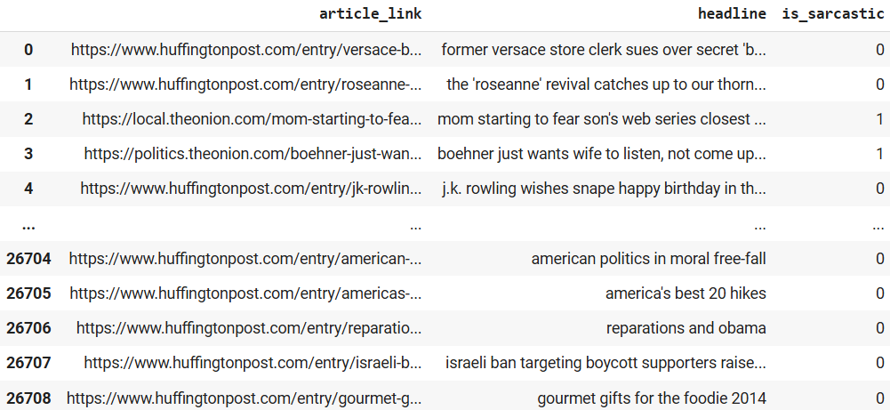
Dataset Loading
data1

Slide 5
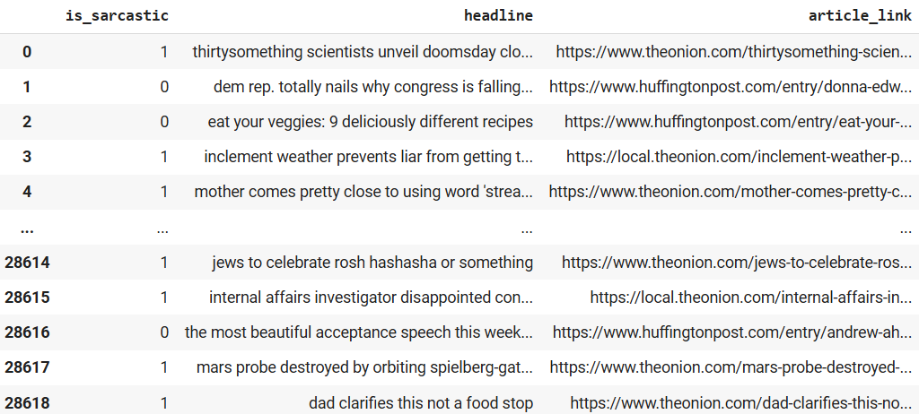
Dataset Loading
data2

Slide 6

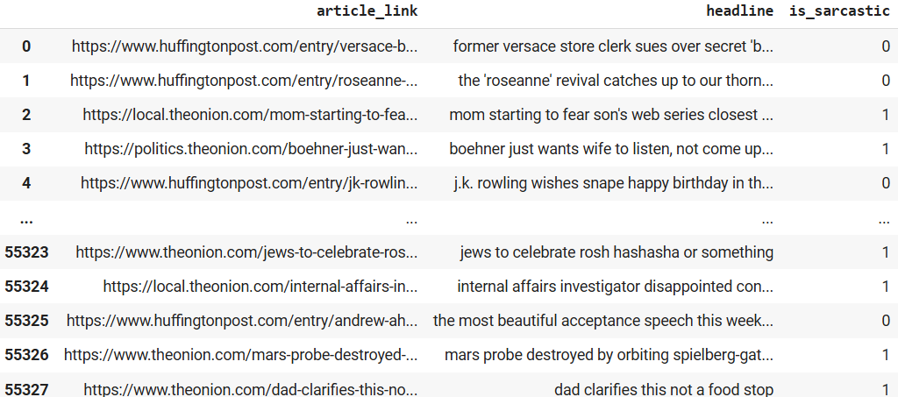
Dataset Concatenation
data

Slide 7
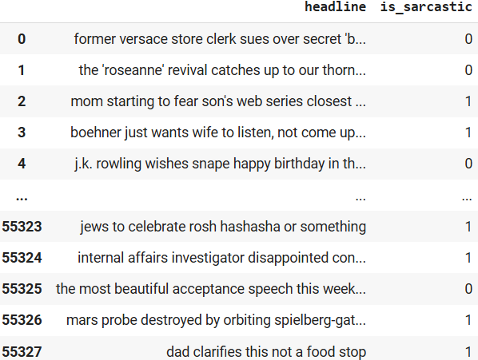
Drop article_link cloumn
data

Slide 8
EDA and Text Preprocessing

Slide 9
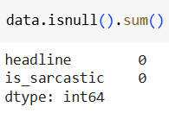
Checking for null values
No null values neither in headline nor in is_sarcastic cloumns

Slide 10
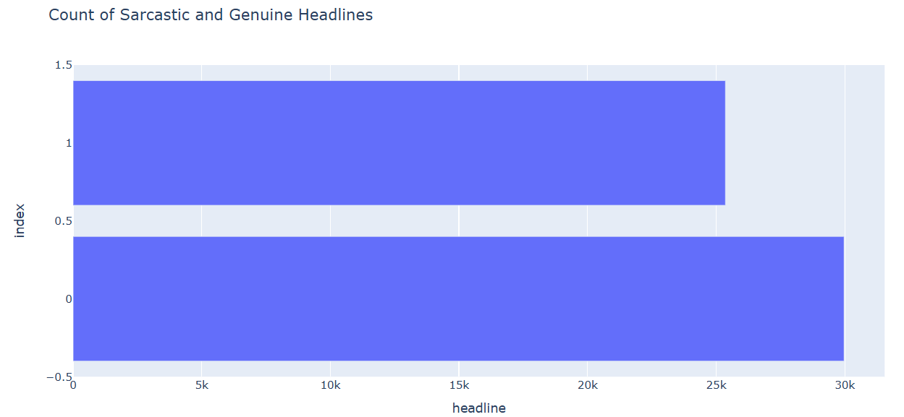
Classes Balance/Imbalance

Slide 11
Text Cleaning & Lemmatization
Each headline should be processed and cleaned in order to be suitable for the classification task. So,
White spaces and new lines are removed
Non-alphanumeric characters are removed
All characters are changed to lowercase
Stop words except “not” are removed
All words are lemmatized to their root verb
Example:
headline = “the 'roseanne' revival catches up to our thorny political mood, for better and worse”
clean_headline = “roseanne revival catch thorny political mood better worse”

Slide 12
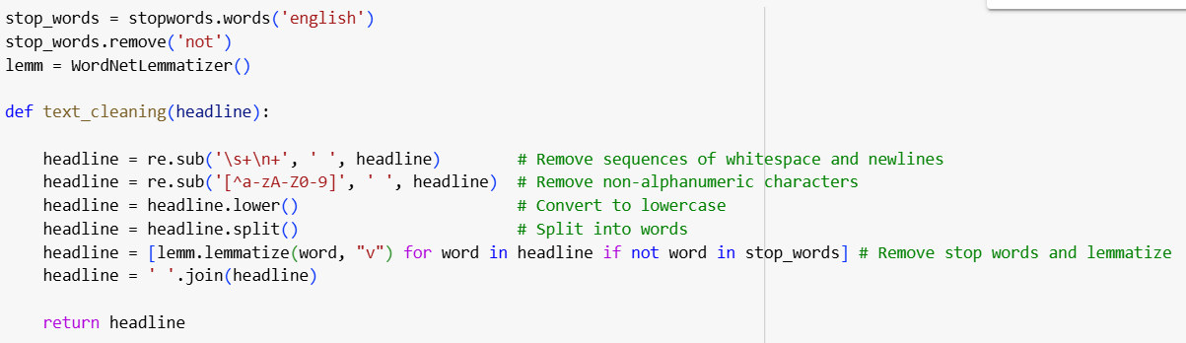
Text Cleaning & Lemmatization

Slide 13
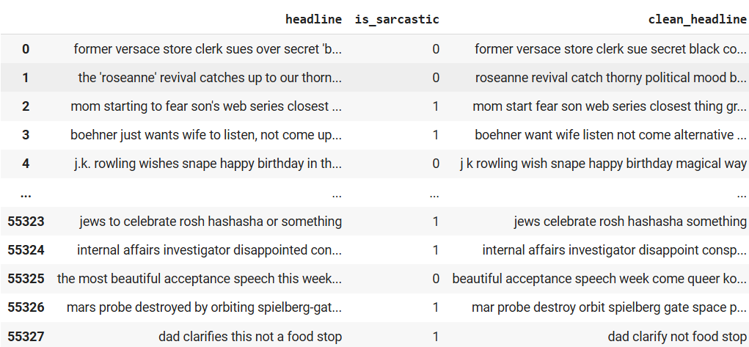
Text Cleaning & Lemmatization
The new clean headline is then added as a new column to the dataset

Slide 14
Features Extraction
Some other features are extracted from the headline column to help in further data analysis and outliers' removal, such as:
Character count
Word count
Average word length
Sentiment (polarity) score

Slide 15
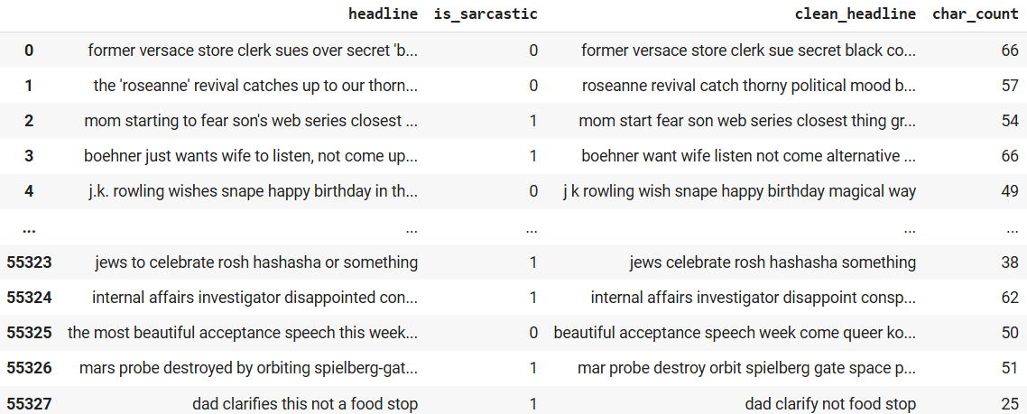
Features Extraction
Extracting char_count from clean_headline

Slide 16
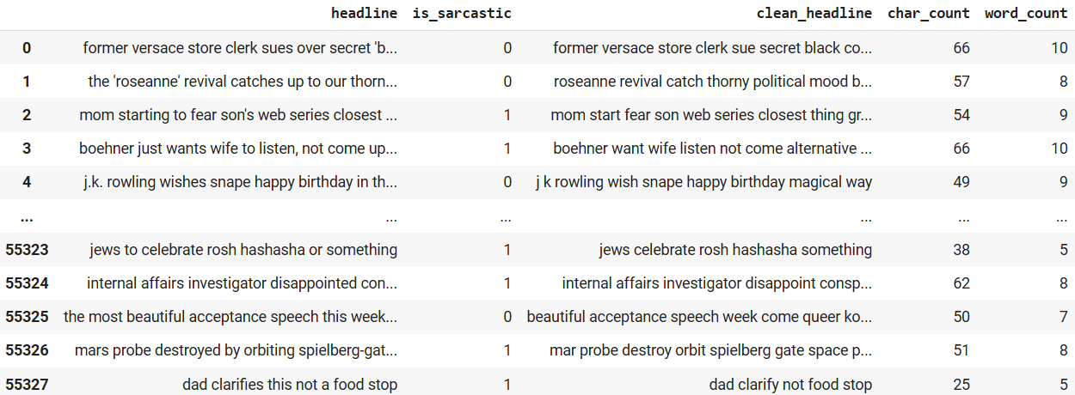
Features Extraction
Extracting word_count from clean_headline

Slide 17
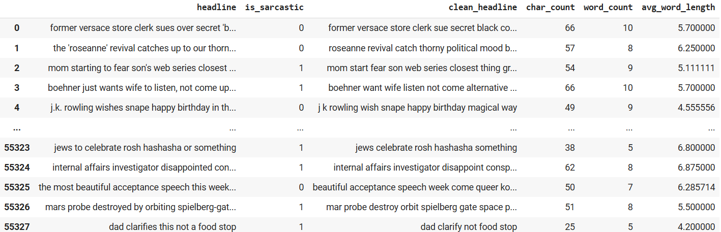
Features Extraction
Extracting avg_word_length from clean_headline

Slide 18
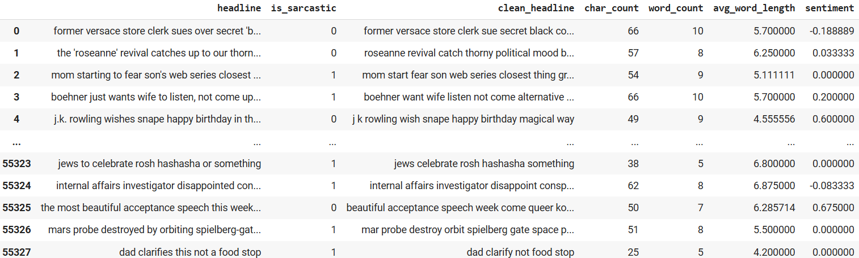
Features Extraction
Extracting sentiment from clean_headline

Slide 19
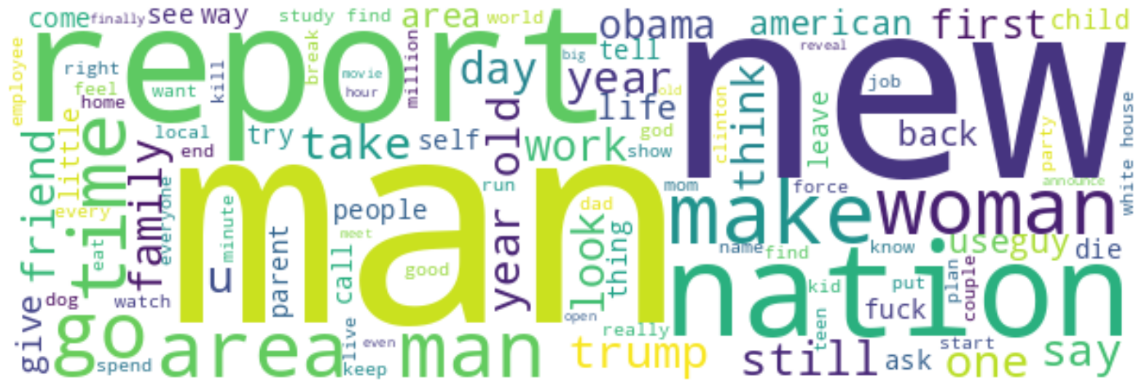
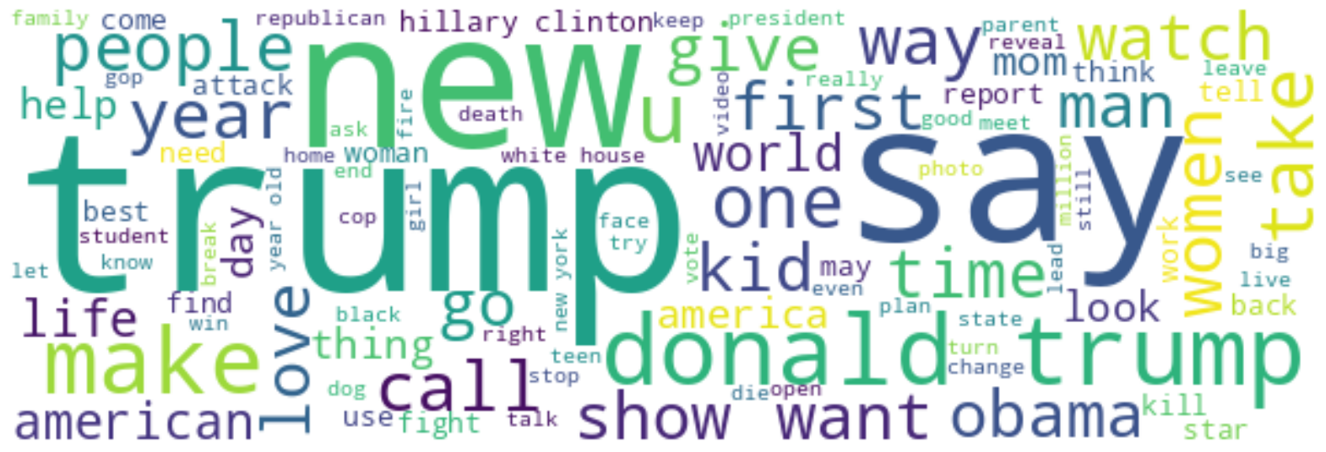
Word Cloud
Genuine
Sarcastic

Slide 20
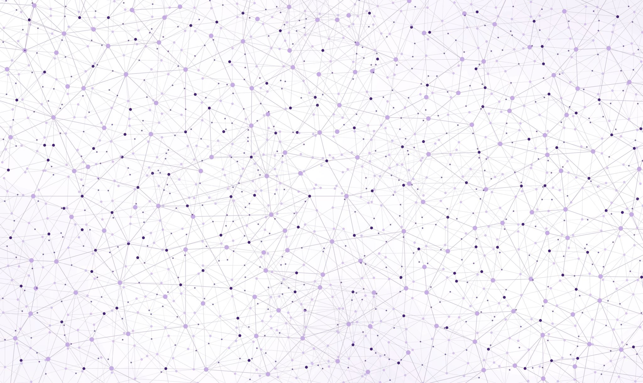
Model Building

Slide 21
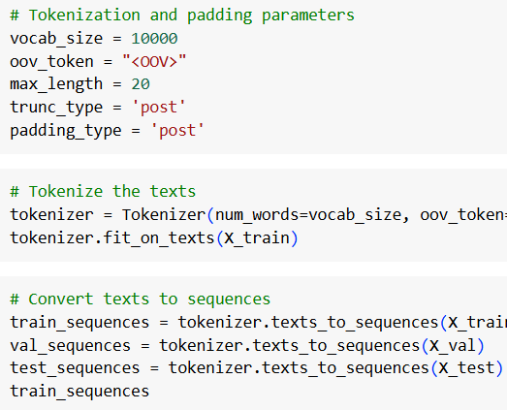
Tokenization
This is the process of converting text into a sequence of tokens (usually words or subwords).

Slide 22
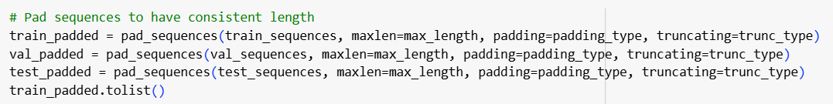
Padding
Since the input sentences can have different lengths, padding ensures that all input sequences have the same length by adding extra tokens (usually zeros) to the shorter sequences and truncating longer ones.

Slide 23
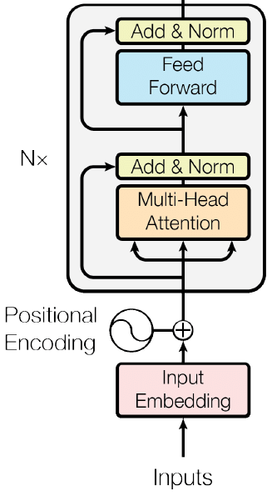
Transformer Encoder Block
A transformer is a deep learning model that adopts the mechanism of self-attention, differentially weighting the significance of each part of the input data
They hold the potential to understand the relationship between sequential elements that are far from each other
They are way more accurate
They pay equal attention to all the elements in the sequence
For the purpose of classification problem, we will only use the encoder block of the original transformers model (encoder-decoder) designed for sequence problems

Slide 24
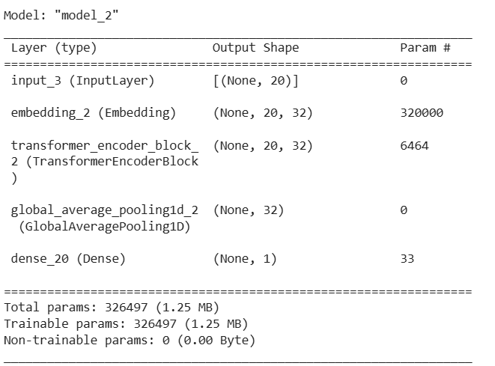
Model Building

Slide 25
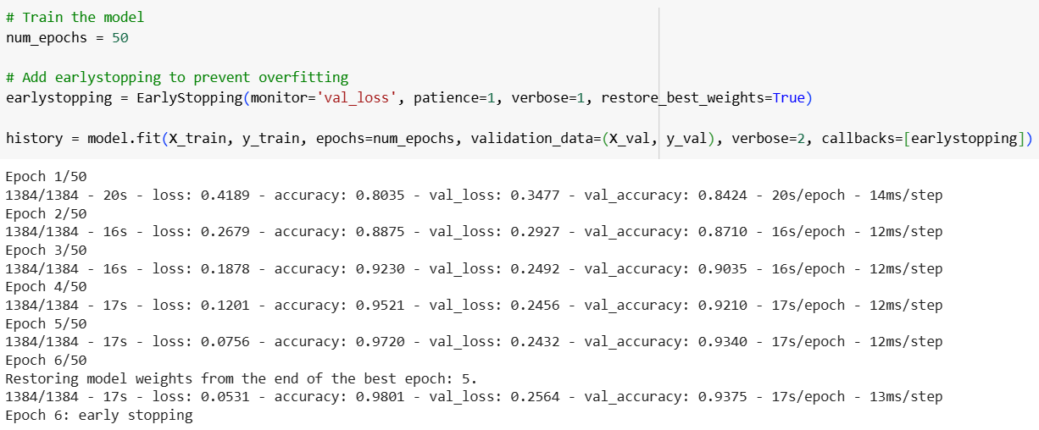
Model Training
Early stopping was added to prevent overfitting.

Slide 26
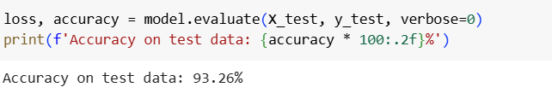
Model Evaluation
The model is evaluated using the test data with an accuracy of 93.26 %

